Slide 1

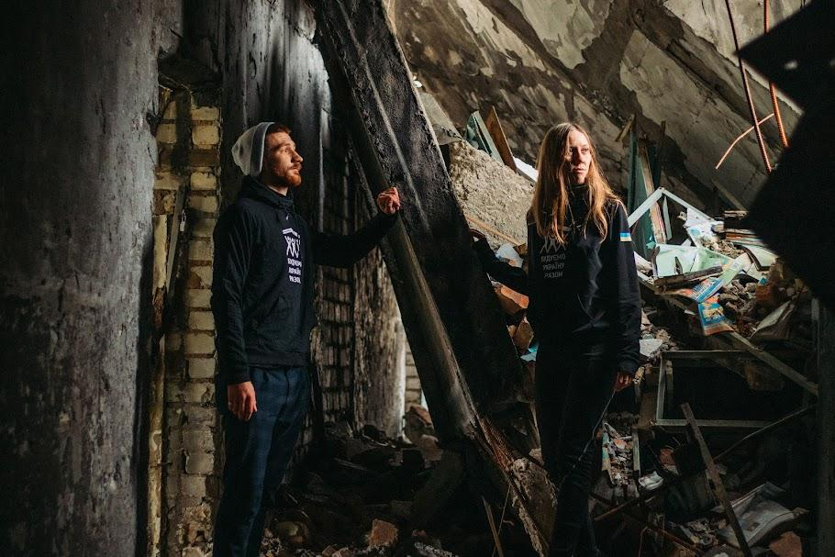

LEARNING FROM DISASTER
European Case Studies of Community-Led Response, Frugal Innovation and Preparedness
www.resilientcommunitiesrise.eu

Slide 2
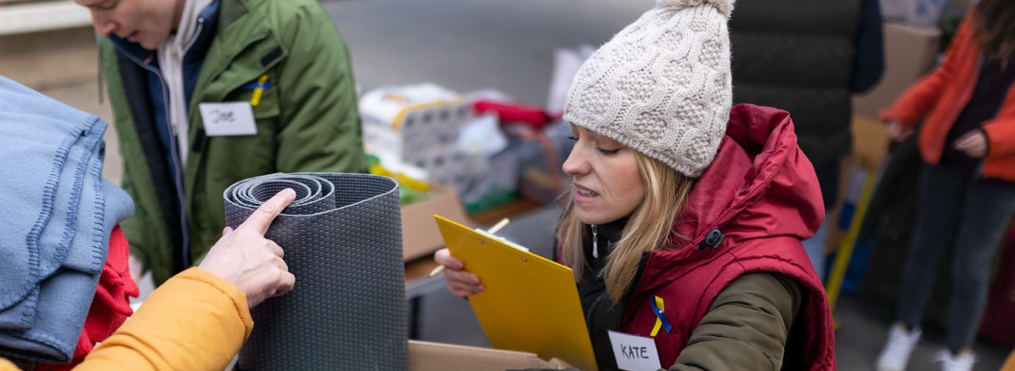
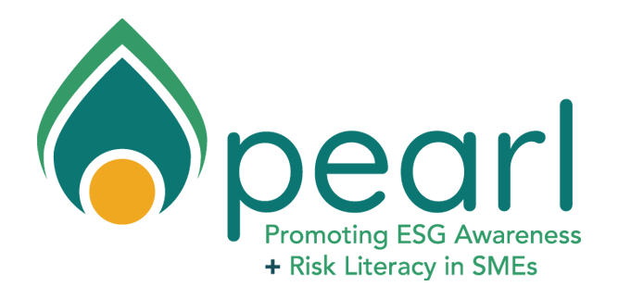
About This Collection
When disaster strikes - whether earthquake, flood, storm, wildfire, or conflict - communities face their greatest test. How they respond, recover, and rebuild reveals profound truths about human resilience, solidarity, and the power of collective action
This collection presents 14 real stories from across Europe, documenting how ordinary people became extraordinary helpers, how broken systems were rebuilt stronger, and how painful lessons transformed into life-saving wisdom. These case studies were collected as part of Work Package 2 (Mapping Resilient Futures) of the RISE Resilient Communities project. Our objective is to research, identify, and compile best practices in community-led recovery, frugal innovation, and sustainable resilience-building across Europe. By documenting successful recovery models, we aim to equip community leaders, adult educators, and local stakeholders with practical insights into what works in disaster response and resilience-building.
Why These Case Studies Matter
Disasters are increasing in frequency and intensity across Europe. Climate change brings more extreme weather - floods, storms, heat waves, and wildfires. Geopolitical instability creates new threats. Communities need proven strategies to prepare for, respond to, and recover from these challenges. Yet too often, valuable knowledge remains isolated in the communities that experienced disasters, never reaching those who could benefit from these hard-won lessons.
This collection breaks down those barriers. Each case study showcases innovative approaches, practical solutions, and transferable strategies that other communities can adapt to their own contexts. From volunteer mobilization in Ukraine to flood coordination in Spain, from earthquake preparedness in Turkey to storm response in Ireland - these stories demonstrate what is possible when communities take charge of their own resilience.

Slide 3
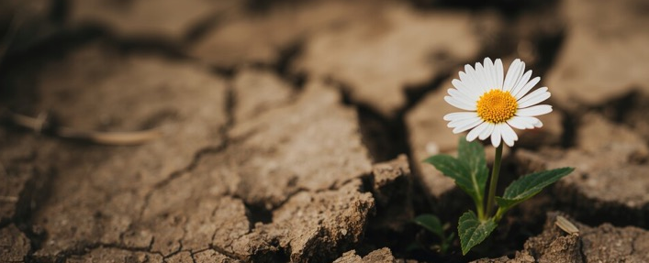
Core Themes
01. Community-Led Response:
Time and again, local communities prove to be the most effective first responders. Neighbors helping neighbors, volunteers mobilizing through social networks, and grassroots organizations providing essential services - these community-led efforts often arrive faster and respond more flexibly than traditional emergency services.
02. Frugal Innovation:
Disasters demand creative solutions with limited resources. These case studies showcase remarkable innovation: using car batteries for phone charging during blackouts, creating community kitchens with portable generators, organizing massive volunteer efforts through WhatsApp, and building resilience hubs in existing community spaces.
03. Preparedness Saves Lives:
Communities that invest in preparedness - training volunteers, establishing coordination systems, pre-positioning supplies, conducting drills - respond far more effectively when disaster strikes. The difference between prepared and unprepared communities can be measured in lives
saved and suffering prevented.
04. Coordination Is Critical:
While grassroots response is powerful, it needs coordination to be effective. Successful responses combine community action with coordinated systems - clear communication, resource management, and cooperation between local volunteers and official agencies.
RISE builds resilient communities by bringing educators and local leaders together to deliver clear, practical learning rooted in local needs.

Slide 4
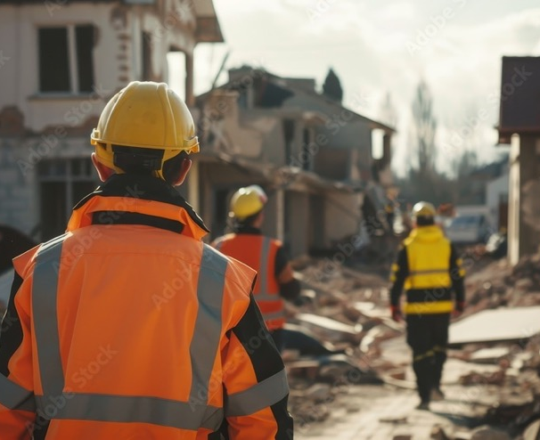
How to Use This Collection
This collection is organized by disaster type to help you find relevant experiences quickly. Whether you are facing floods, earthquakes, storms, or other disasters, you can turn directly to that chapter and learn from communities that have confronted similar challenges.
01. For Community Leaders:
Identify strategies you can adapt to your community. Consider what preparation steps you can take now, before disaster strikes.
02. For Adult Educators:
Use these real-world examples for teaching disaster preparedness and resilience. They demonstrate concepts in action and inspire learners.
03. For Policy Makers:
These lessons inform policy decisions about disaster preparedness, emergency coordination, and resilience building.
04. For Researchers:
These case studies document diverse approaches to disaster response and recovery, offering insights for further research and analysis..

Slide 5
Case Study Compendium
Chapter 1: Conflict & War
Ukraine: Rebuilding Social Connections 7
Ukraine: Surviving Winter Without Power 9
Chapter 2: Floods & Storms
Spain: Valencia DANA Floods 2024 12
Ireland: Storm Éowyn Response 2025 14
Ireland: Leitrim PPN Storm Coordination 16
Ireland: Monaghan Multi-Hazard Preparedness 18
Ireland: Youghal Coastal Flooding 20
Italy: 2023 Emilia Romagna Floods 22
Turkey: 2021 Kastamonu Flash Floods 24
Chapter 3: Earthquakes
Turkey: 1999 Marmara Earthquake 27
Turkey: Building AFAD National System 29
Turkey: 2023 Kahramanmara Earthquakes 31
Chapter 4: Wildfires
Spain: 2025 Wildfire Season 34
Chapter 5: Environmental Disasters
Italy: 2018 VAIA Storm Forest Recovery 37

Slide 6
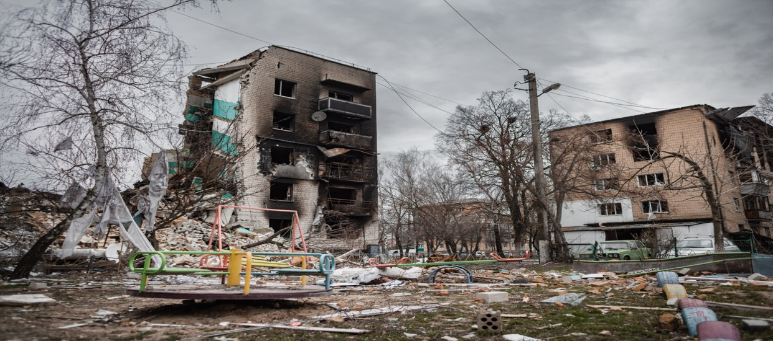
01
Conflict & War
War and armed conflict create unique disasters combining immediate destruction with long-term trauma. Communities face not just physical destruction but deliberate targeting, prolonged uncertainty, and systematic attempts to break civilian morale. The challenges for individuals and communities are multifaceted and interconnected.
Physical safety is never assured. Social networks fracture as families separate, neighbours evacuate and trusted institutions collapse. Children miss years of education. Adults cannot work in their professions. The elderly struggle far from familiar surroundings and medical care. Economic devastation compounds these challenges, savings depleted, businesses destroyed, career trajectories interrupted. Yet amid this devastation, remarkable resilience emerges.
The following Ukrainian case studies demonstrate how communities create spaces of normalcy within chaos, how grassroots organizations fill gaps that traditional institutions cannot reach, and how volunteers, often displaced themselves, become the backbone of response.
They showcase the innovation that emerges when people refuse to let crisis define their future, instead creating community, connection, and hope even under the most extreme circumstances.

Slide 7
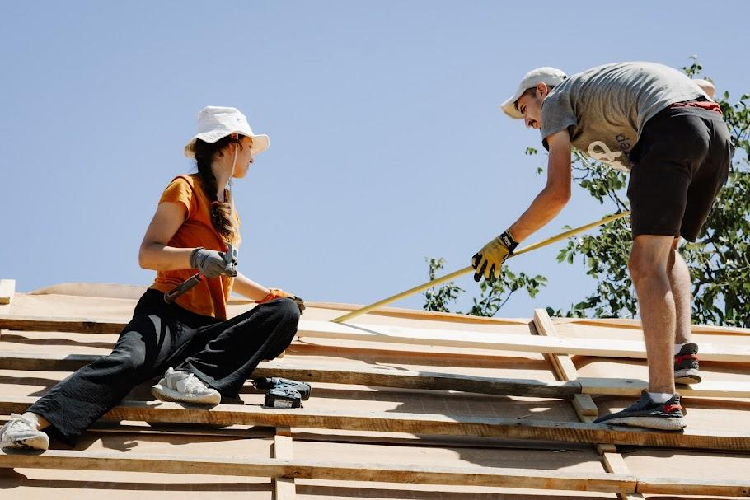
Conflict & War
Ukraine: Rebuilding Social Connections
Building Ukraine Together - volunteer and a community programs in Crisis
Since 2014, Russia's invasion has displaced millions and fractured communities. Building Ukraine Together (BUR) created volunteer and a community programs where displaced people reconnect, learn, and find support - transforming crisis into opportunity for social resilience.
The Challenge
The war created massive educational and socialization gaps. Millions lost access to schools, community centers, and social networks. Many evacuated to unfamiliar cities, isolated from support systems. Depression, anxiety, and trauma became widespread. Traditional institutions couldn't reach everyone needing help, especially in newly formed displaced communities.

Slide 8
Ukraine: Rebuilding Social Connections
Volunteer and a community programs
BUR created "Volunteer and a community programs" - is mobility-based volunteering, where youth travel, collaborate with local communities, and contribute to rebuilding war-affected areas. This fosters skills development, trust, social cohesion, and personal growth. Programs evolve based on what
people want and need. BUR applies a “small responsibilities” strategy, allowing participants to gradually take on more roles and leadership. This both empowers youth and strengthens the organization’s sustainability.
What Makes It Work
By training camp leaders, BUR has significantly expanded its impact, increasing the number of participants and communities involved. Many alumni continue volunteering or pursue careers in related fields. The holistic approach tackles interconnected challenges - social isolation, loss of purpose, educational gaps, economic uncertainty. Participants aren't passive aid recipients but active contributors who lead activities and shape their community. This restores dignity, control, and purpose.
Results and Impact
BUR has significantly increased its reach, engaging over 10 000 young people involved through its volunteer leadership model. The program strengthens youth networks, builds leadership skills, and encourages long-term civic engagement, with many participants continuing as organizers or launching their own initiatives. It also equips youth with resilience, adaptability, and teamwork skills, supporting social cohesion and contributing to the development of civil society in wartime Ukraine.
Key Lesson.
In protracted crises, addressing social and psychological needs is as critical as meeting material needs. In the context of war, such a network of active young people plays a key role in strengthening civil society and advancing non-formal education. Investing inlocal volunteers and flexible programming creates resilient support systems that adapt to changing circumstances.

Slide 9
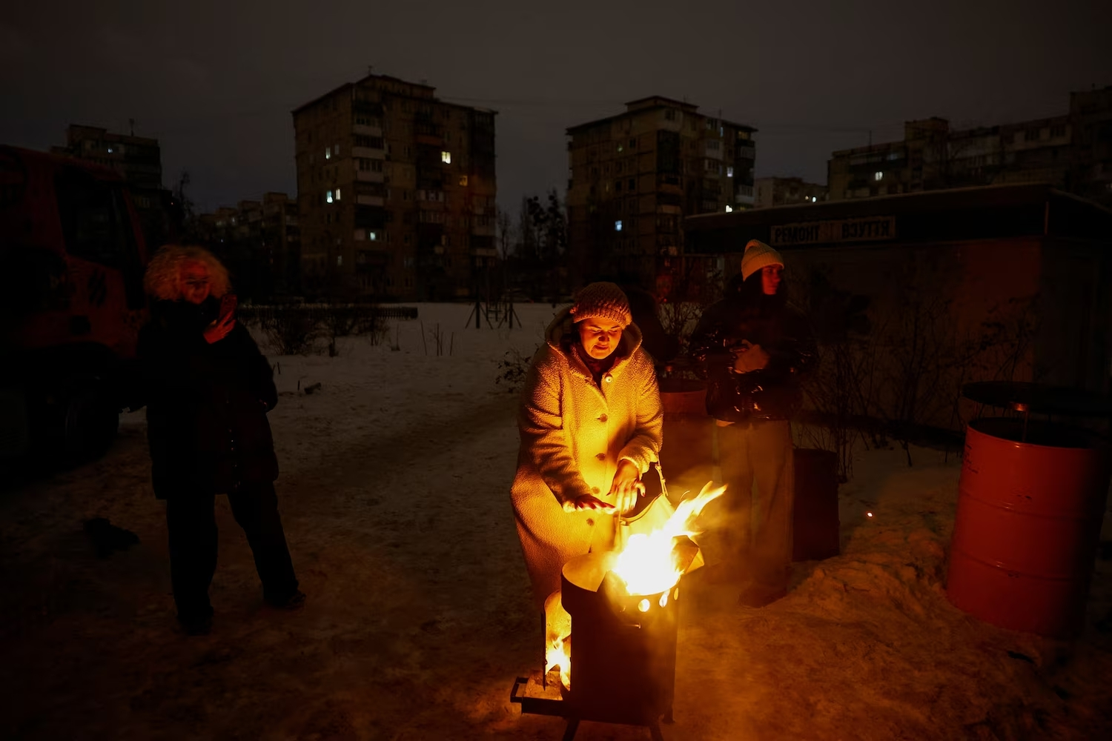
Conflict & War
Ukraine: Surviving Winter Without Power
Obereg of Your Hope — Local volunteer initiativet
During winter 2025-2026, Russia systematically attacked Ukraine's energy infrastructure, leaving millions without heat or electricity in sub-zero temperatures. Obereg a local volunteer initiative that produces and distributes trench candles and portable wood- and coal-fuelled stoves to communities affected by shelling and infrastructure damage, including in the Kharkiv region.
The Crisis
Weaponizing winter became a key Russian strategy. Missile strikes deliberately targeted power plants, substations, and heating systems across Ukraine. By December 2025, rolling blackouts affected virtually the entire country. Some areas went days or weeks without electricity. With temperatures below -10°C, this became life-threatening, especially for elderly people, families with children, and those with medical conditions.

Slide 10
Ukraine:
Surviving Winter Without Power
Local volunteer initiativet
The intervention overview focuses on Obereg of Your Hope, a local volunteer initiative that produces and distributes trench candles and portable wood- and coal-fuelled stoves to communities affected by shelling and infrastructure damage, including in the Kharkiv region. These simple devices provide households with a practical means to cook, heat water and maintain a minimum level of warmth when centralised systems fail.
Innovation Under Pressure
The best practices highlighted are, first, the decentralised community production and delivery of low-cost heating tools that preserve dignity and continuity of daily life during prolonged outages, and second, the strengthening of horizontal solidarity through direct, bottom-up support that connects practical assistance with trust-building inside affected communities.
Broader Impact
The case shows that in conflict conditions, community-led recovery may depend as much on modest, rapidly deployable solutions as on large-scale infrastructure repair. Its results include access to warm food and basic domestic functionality in conditions otherwise considered unliveable, while its wider impact lies in reinforcing community ties, mutual aid and a sense of hope.
Key Lesson.
When critical infrastructure becomes a war target, community initiatives provide essential services and maintain social cohesion. Simple solutions - backup power, warm spaces, community kitchens - become lifesaving when implemented at scale. The key is mobilizing local volunteers and resources rather than waiting for external aid.

Slide 11
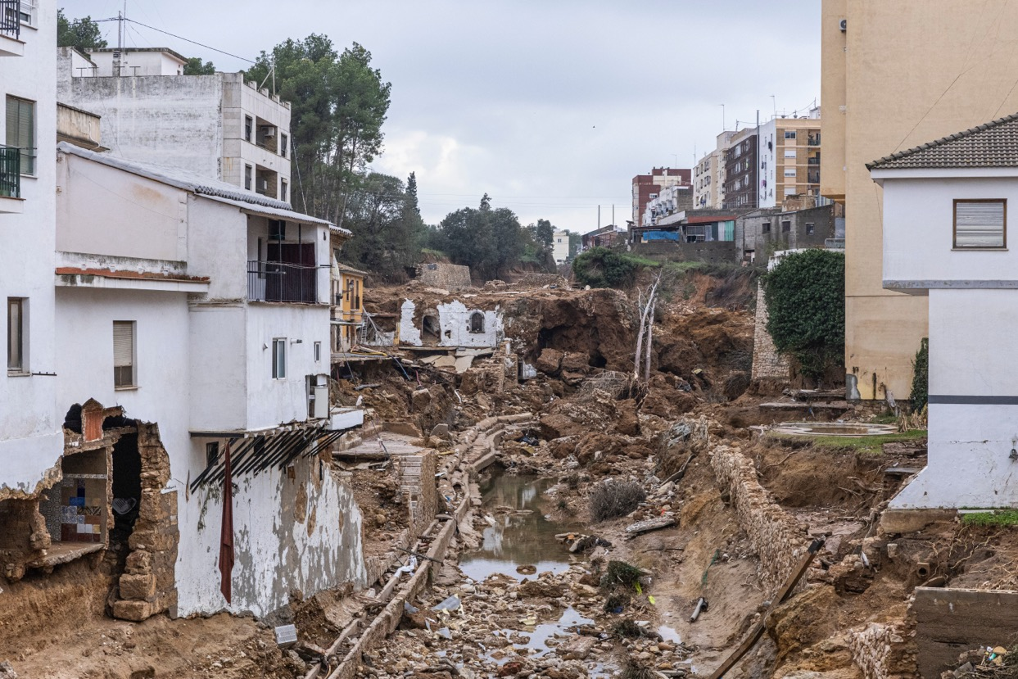
02
Floods & Storms
Floods and severe storms represent Europe's most common climate-related disasters, with increasing frequency and intensity. Unlike some disasters that strike once and pass, water-related events are becoming the new normal for many communities, forcing a fundamental rethinking of how we live alongside rivers, coasts, and weather systems. The challenges these disasters pose are both immediate and long-lasting.
Rural communities face particular challenges—when the power goes out in isolated areas, people can be cut off for days without heat, communication, or ability to cook food or pump water. Elderly residents and those with medical conditions face
life-threatening situations when electricity-dependent equipment fails. The economic and psychological impacts compound over time. Flood-damaged homes require months to dry and repair, if they can be salvaged at all. Businesses lose stock, equipment, and customers.
Yet the following seven case studies also reveal extraordinary adaptive capacity. They showcase diverse approaches from immediate emergency coordination to long-term climate adaptation, demonstrating how communities can build resilience against water.

Slide 12
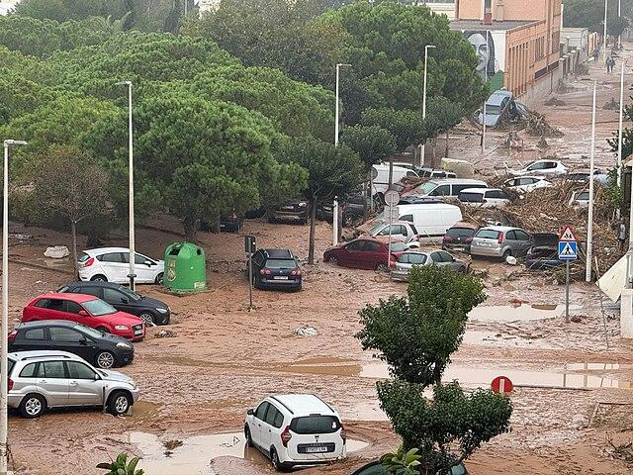
Floods & Storms
Spain: Valencia DANA Floods 2024
When Volunteers Became First Responders
In October 2024, catastrophic rainfall hit Valencia. Within hours, towns were underwater. What followed was one of Europe's largest spontaneous volunteer mobilizations, with over 15,000 people rushing to help - demonstrating both the power and coordination challenges of mass civic response.
The Disaster
A DANA weather system stalled over Valencia province. Within 8 hours, some areas received over 400mm of rain—a year's worth in a day. The Horta Sud region was devastated. Flash floods swept through towns, turning streets into rivers. Cars tossed like toys. Ground floors filled with water and mud. Over 200 people died in Spain deadliest flood in decades.

Slide 13
Spain:
Valencia DANA Floods 2024
Volunteer Mobilization
Within 24 hours, thousands of volunteers descended on affected areas with shovels, brooms, and water pumps. Social media became the coordination tool - volunteer groups forming spontaneously on WhatsApp and Telegram. Young people especially led the effort, organizing transport, distributing supplies, and working shoulder-to-shoulder with residents. By day three, over 15,000 volunteers were active across the region, many working 12-hour days for weeks.
Coordination Challenges and Solutions
The massive response created coordination challenges. Too many people arrived at some locations while other areas lacked help. The Horta Sud Consortium and local municipalities created volunteer registration
centers, developed digital platforms matching volunteers with needs, established safety protocols and protective equipment, coordinated with official emergency services, set up community kitchens to feed workers, and organized debris removal and waste management.
Long-Term Recovery
Beyond immediate cleanup, the region faces years of recovery: housing reconstruction, business restoration, infrastructure repair, and trauma recovery. The consortium is working with RISE and European partners to develop resilience strategies including improved flood warning systems, climate-adapted infrastructure, and community preparedness programs.
Key Lesson.
Spontaneous volunteer mobilization can be incredibly powerful, but needs coordination structures to be effective. Social media enables rapid organization but can’t replace systematic coordination. Communities should prepare volunteer management systems before disasters strike, so when people want to help, they can be directed where needed most.

Slide 14
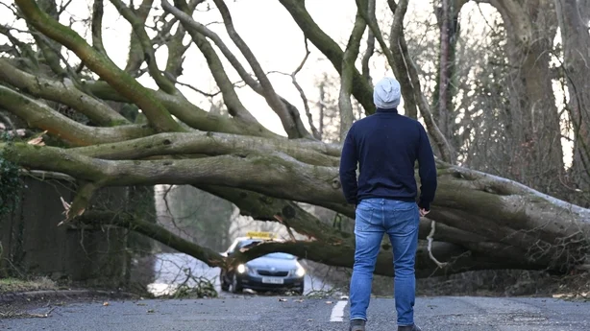
Floods & Storms
Ireland: Storm Éowyn Response 2025
Community Hubs as Resilience Centers
Storm Éowyn brought severe winds and widespread power outages to Ireland. County Leitrim demonstrated how community centers, when prepared and resourced, serve as
critical resilience hubs - providing warmth, power, information, and social support during storms.
The Storm
Storm Éowyn hit with winds exceeding 100 mph in some areas. Thousands of trees fell, blocking roads and damaging power lines. Over 700,000 homes lost electricity, some for several days. In rural areas like Leitrim, residents faced cold homes, no water pumps, and isolation as roads became impassable.

Slide 15
Ireland:
Storm Éowyn Response 2025
Community Support Hubs in Action
Learning from previous storms, Leitrim communities had prepared. Local education centers and community buildings activated as support hubs, offering power and warmth through buildings with generators, information centers with updates on power restoration and road clearances, social connection spaces for isolated elderly residents, hot meals from community kitchens, and coordination points for volunteer tree-clearing efforts.
Preparedness Made the Difference
Effectiveness came from advance preparation: community centers invested in generators and backup power, emergency plans identified which buildings would serve as hubs, volunteer networks were established before the storm, communication systems were tested and ready, supplies were pre-positioned, and vulnerable residents were registered and checked on systematically.
Key Lesson.
Community buildings equipped with backup power and emergency supplies serve as critical resilience infrastructure during severe weather. The key is preparing before disasters strike - investing in equipment, training staff and volunteers, and
establishing coordination systems. Small investments in community preparedness yield major benefits when storms hit.

Slide 16
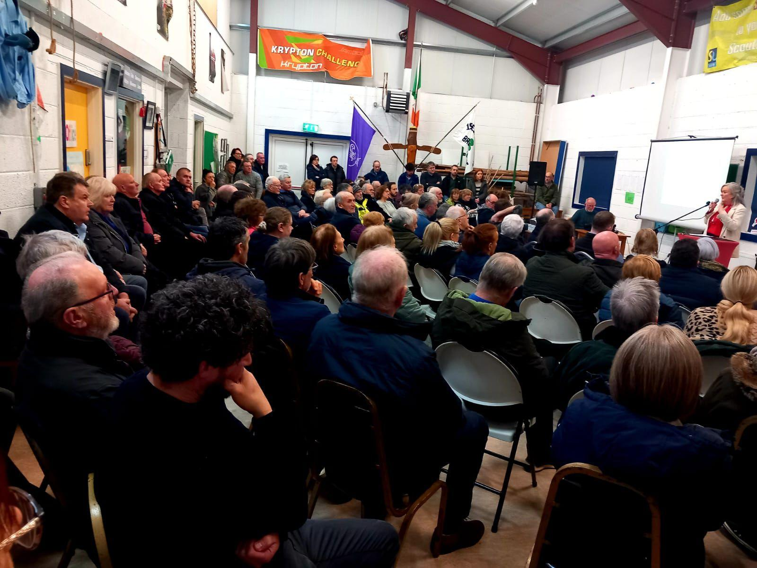
Floods & Storms
Ireland: Leitrim PPN Storm Coordination
Building Community Networks for Preparedness
Leitrim's Public Participation Network developed accessible communication systems and coordination structures that proved invaluable during multiple storm events, showing how community networks enhance resilience through clear communication and systematic preparedness.
Building Preparedness Networks
The Leitrim PPN recognized that effective disaster response requires preparation during calm times. They built a network connecting community groups, voluntary organizations, and local authorities. This network meets regularly to share information, coordinate resources, and plan emergency responses. When storms hit, these relationships enable rapid, coordinated action.

Slide 17
Ireland:
Leitrim PPN Storm Coordination
Key Innovations
Accessible Communication: Information disseminated through multiple channels - text messages, social media, community radio, print bulletins - ensuring everyone receives updates regardless of age or digital access.
Vulnerable Person Registry: Systematic identification and check-in procedures for elderly residents, people with disabilities, and those living alone.
Pre-positioned Resources: Emergency supplies distributed across the county based on vulnerability assessments.
Trained Volunteer Pool: Community members trained in first aid, welfare checks, and emergency response.
Key Lesson.
Effective disaster response grows from strong community networks built during normal times. Investing in community coordination, accessible communication, and volunteer training creates resilience capacity that activates automatically when crisis strikes.

Slide 18
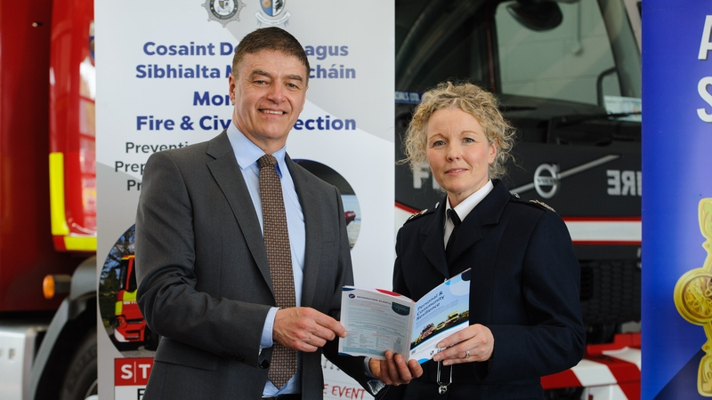
Floods & Storms
Ireland: Monaghan Multi-Hazard Preparedness
Community Resilience Through Education
County Monaghan developed a comprehensive community resilience program addressing multiple hazards - floods, storms, power outages, and health emergencies. Their booklet and training approach demonstrates how proactive education builds preparedness across diverse risks.
The Challenge
Monaghan faces multiple disaster risks: severe weather including flooding, health emergencies, fires, power outages, and security concerns. Rather than reacting to each crisis separately, the county decided to build comprehensive community resilience through education and preparedness.

Slide 19
Ireland: Monaghan
Multi-Hazard Preparedness
Community Resilience Booklet
The county developed an accessible resilience booklet providing practical guidance for households on preparing for various emergencies. The booklet covers emergency planning, supply stockpiling, communication strategies, knowing when to evacuate versus shelter in place, supporting vulnerable neighbors, and recovery resources. It's designed to be clear, actionable, and relevant to rural Irish contexts.
Implementation Strategy
The booklet is distributed through multiple channels: schools, community centers, local businesses, and door-to-door in high-risk areas. Training sessions help community leaders understand and teach preparedness concepts. Local authorities work with community groups to identify vulnerable residents and ensure they receive support preparing for emergencies.
Key Lesson.
Proactive community education builds resilience across multiple hazard types. Simple, accessible guides combined with community training create a foundation of preparedness. When disasters strike, prepared communities respond more effectively and recover more quickly.

Slide 20
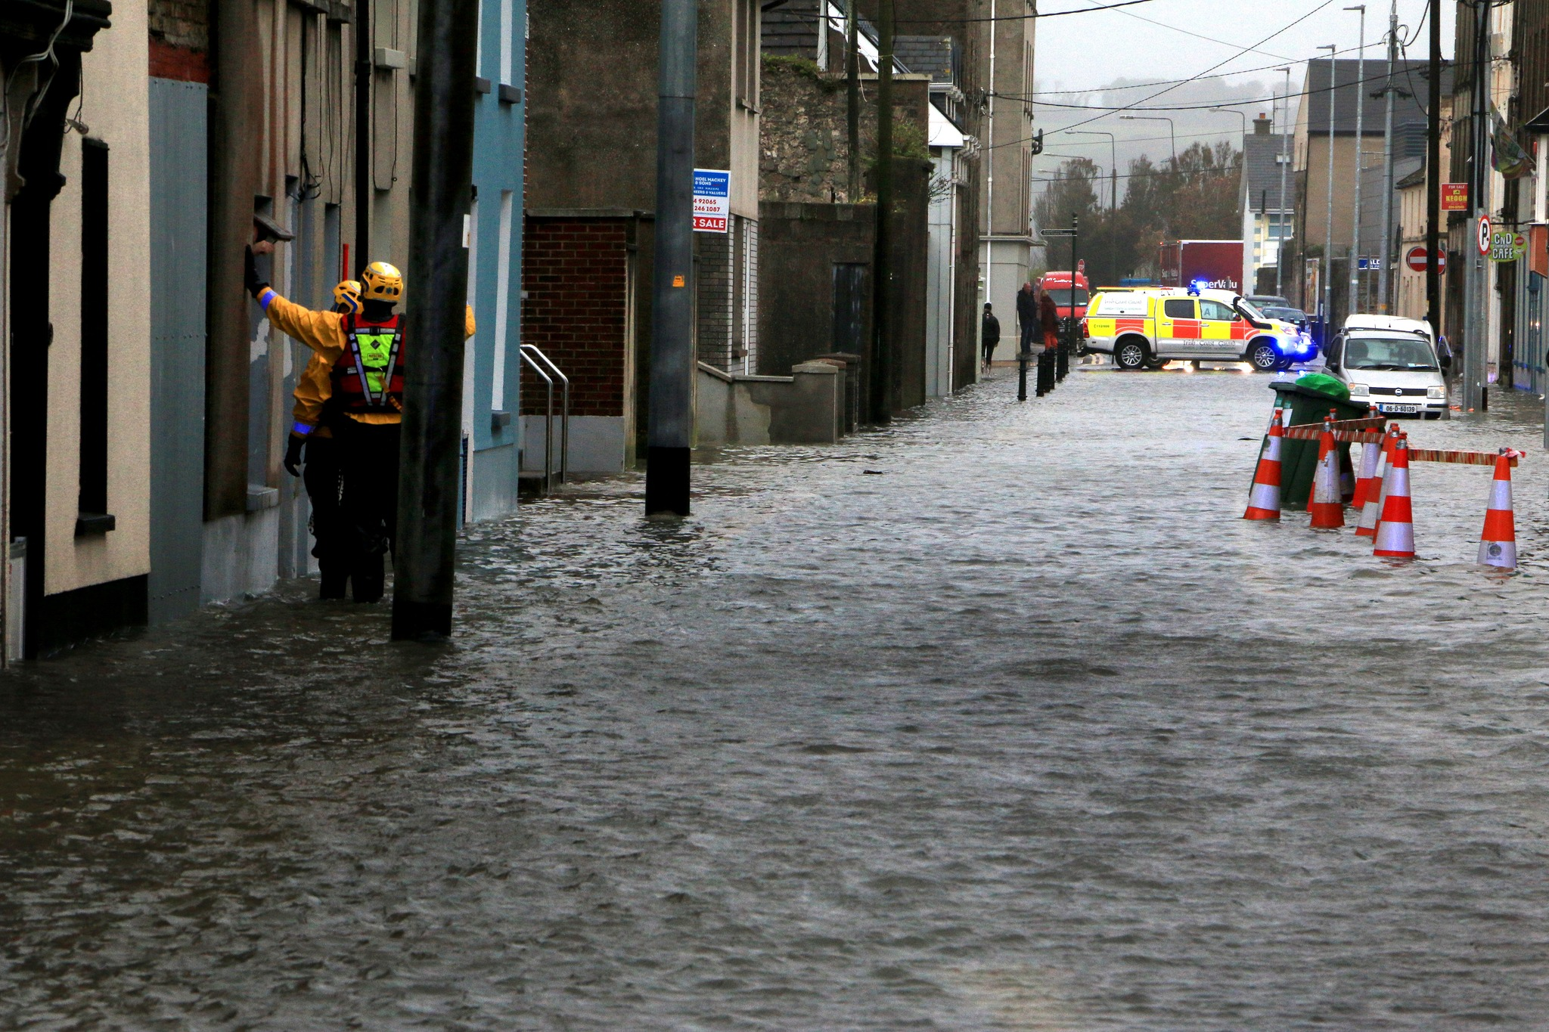
Floods & Storms
Ireland: Youghal Coastal Flooding
Adapting to Rising Seas and Storms
The coastal town of Youghal in County Cork faces increasing flood risks from climate change, sea-level rise, and more intense storms. Their adaptation approach combines infrastructure improvements with community preparedness and nature-based solutions.
The Risk
Youghal sits at the mouth of the Blackwater River, making it vulnerable to both coastal flooding from storm surges and fluvial flooding from river overflow. Climate change is intensifying both risks. Recent decades have seen more frequent and severe flooding events affecting homes, businesses, and critical infrastructure.

Slide 21
Ireland: Youghal
Coastal Flooding
Adaptation Approach
Youghal is implementing multi-layered flood protection: coastal defenses and flood walls in critical areas, improved drainage and water management systems, nature-based solutions like wetland restoration to absorb floodwater, early warning systems giving advance notice of flood risk, community preparedness training, and relocation support for the most vulnerable properties.
Community Engagement
Success requires community buy-in. Local authorities conduct regular consultations, explaining flood risks and adaptation options. Residents participate in preparedness drills. Vulnerable households receive personalized flood plans. Businesses develop continuity strategies. This engagement ensures adaptation measures reflect community needs and values.
Key Lesson.
Coastal communities must adapt to climate change through combined approaches: protective infrastructure, nature-based solutions, early warning systems, and community preparedness. Engaging residents in planning and preparation ensures adaptation measures are effective and supported.

Slide 22
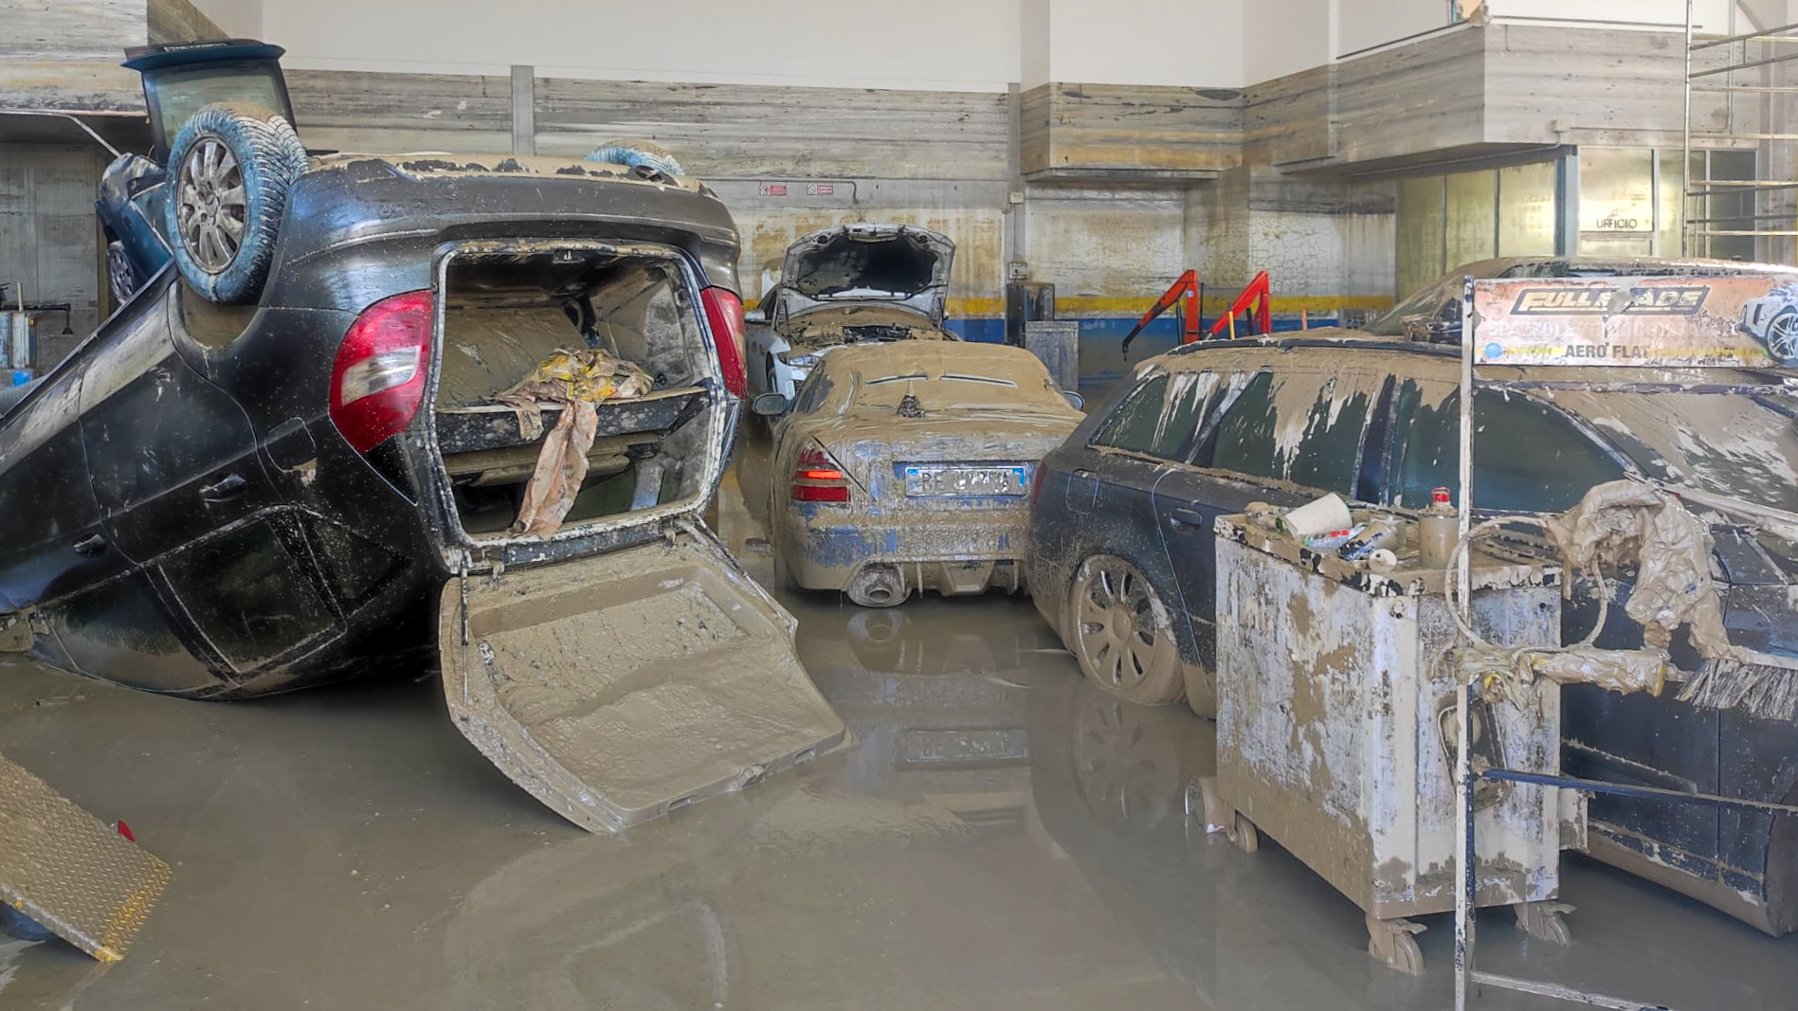
Floods & Storms
Italy: 2023 Emilia Romagna Floods
Coordinating Response Across Multiple Levels
In May 2023, exceptional rainfall caused devastating floods and landslides across Emilia Romagna.
The disaster required coordination among national, regional, and local authorities, demonstrating Italy's multi-level civil protection system in action.
The Disaster
Between May 1-17, 2023, exceptional rainfall hit central-northern Italy. Some areas received 500mm of rain in 36 hours - equivalent to half a year's rainfall. Rivers overflowed, triggering widespread flooding and landslides. Thousands of people evacuated. Critical infrastructure was damaged. Agricultural areas were inundated. The disaster affected multiple provinces, requiring coordinated response at unprecedented scale.

Slide 23
Italy: 2023 Emilia Romagna Floods
Multi-Level Coordination
Italy's National Civil Protection Department coordinated the overall response, reinforced from mid-May as the scale became clear. Regional authorities managed provincial operations. Local municipalities conducted evacuations and immediate assistance. The Agency for Territorial Safety assessed damage and planned recovery. An Extraordinary Commissioner was appointed to oversee reconstruction with dedicated funding and sectoral ordinances.
Recovery and Reconstruction
The long-term recovery program addresses infrastructure, watercourses, and private rebuilding. Structured reconstruction under the Extraordinary Commissioner ensures coordination and standards. Sectoral ordinances provide clear guidance for different reconstruction aspects. Dedicated funding enables comprehensive recovery rather than piecemeal repairs.
Key Lesson.
Large-scale disasters require clear coordination across governmental levels. Italy's structured civil protection system, with defined roles from national to local, enables effective response and organized recovery. Appointing an extraordinary commissioner for reconstruction provides necessary authority and resources for comprehensive rebuilding.

Slide 24
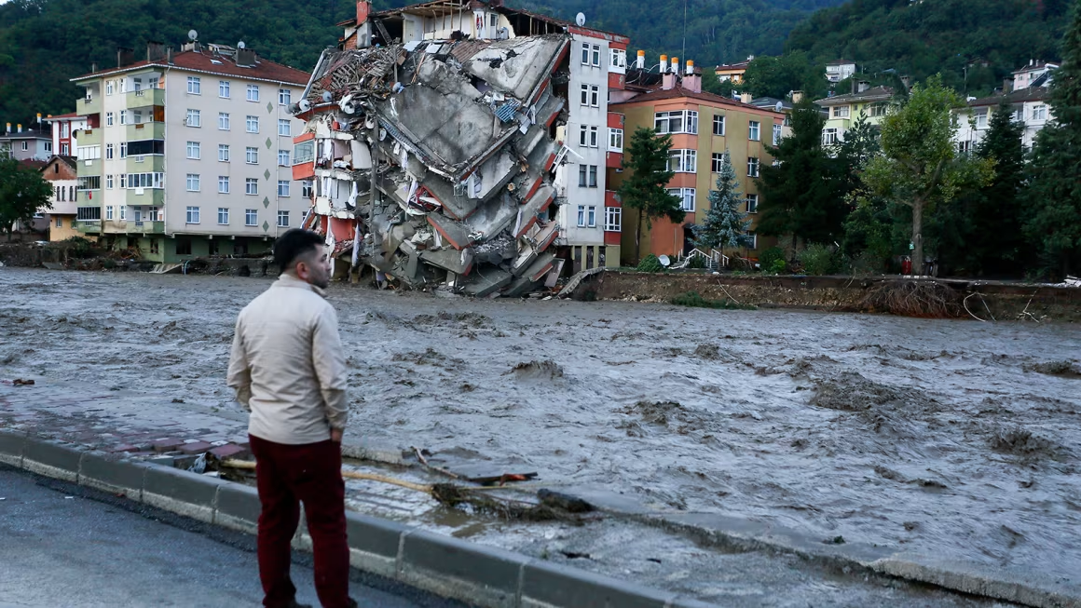
Floods & Storms
Turkey: 2021 Kastamonu Flash Floods
When Rivers Rise: Responding to Extreme Weather
In August 2021, extreme rainfall triggered devastating flash floods in Turkey Black Sea region, particularly affecting Bozkurt. The disaster highlighted both climate challenges and the importance of community resilience and coordinated emergency response.
The Disaster
On August 11, 2021, extreme rainfall - once-in-a-century intensity - fell on the mountainous Black Sea region. Rivers swelled rapidly, overwhelming banks. In Bozkurt, the Ezine River became a raging torrent, sweeping through the town center. Buildings collapsed into the water. Cars carried away like toys. Families fled to upper floors as water rushed through homes.

Slide 25
Turkey: 2021 Kastamonu
Flash Floods
Emergency Response
Emergency services faced unique challenges rescuing people in an active flood. Helicopters airlifted stranded residents from rooftops. Boats navigated debris-filled streets. AFAD mobilized resources, but damaged roads made access difficult. Local volunteers formed human chains to pull people from water. The community's fire station became a coordination hub, with citizens and officials working side by side.
Recovery and Adaptation
As floodwaters receded, thick mud covered everything. Power and water systems were destroyed. Families had lost everything. Emergency teams focused on basics: shelter, food, clean water, medical care. Mobile kitchens fed thousands. Temporary shelters housed displaced families. Recovery meant rethinking the relationship with the river: engineers redesigned flood defenses, buildings in high-risk areas were relocated, new early warning systems were installed, and the community developed evacuation plans and conducted regular drills.
Key Lesson.
Climate change brings more extreme weather events. Communities must adapt through better infrastructure, early warning systems, and local preparedness. When disaster strikes, local knowledge and community networks are as important as official response systems.

Slide 26
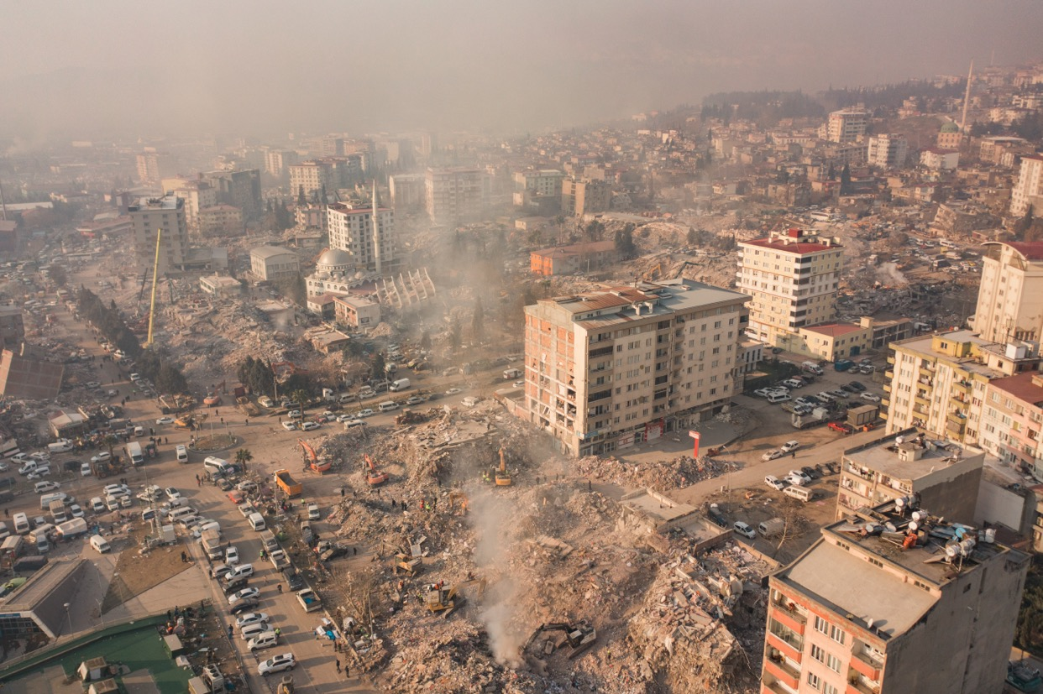
03
Earthquakes
Turkey experience with devastating earthquakes has transformed the nation's disaster management approach. These cases trace that evolution - from the 1999 Marmara earthquake exposing critical vulnerabilities, through developing AFAD as a coordinated national response system, to the 2023 Kahramanmara earthquakes testing Turkey preparedness at unprecedented scale.
Click to type…

Slide 27
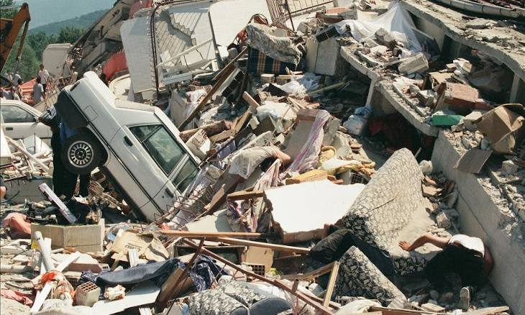
Earthquakes
Turkey: 1999 Marmara Earthquake
Transforming Disaster Response and Building Codes
On August 17, 1999, a devastating earthquake struck northwestern Turkey, claiming over 17,000 lives and exposing critical weaknesses in building standards and emergency response. This disaster became a turning point for Turkey approach to disaster management.
What Happened
A magnitude 7.4 earthquake struck the heavily populated Marmara region at 3:02 AM when most people were asleep. Thousands of buildings collapsed within seconds, trapping families in rubble. The disaster affected major cities including Kocaeli, Sakarya, and Yalova, with over 600,000 people left homeless.

Slide 28
Turkey: 1999 Marmara Earthquake
The Response
Emergency responders faced overwhelming challenges. Search and rescue teams from around the world worked day and night to find survivors. Temporary tent cities sheltered displaced families. The Turkish military deployed thousands of personnel providing medical care, food, and water to affected communities.
Long-Term Changes
This tragedy led to major reforms. The government completely overhauled building codes, introducing strict seismic safety standards. A new Compulsory Earthquake Insurance system protected homeowners. Most importantly, Turkey established AFAD to coordinate national disaster response. Universities launched earthquake engineering programs to train safety experts.
Lasting Impact
Today, Turkey has one of Europe's most advanced disaster management systems. New buildings must meet rigorous earthquake-resistant standards. Regular earthquake drills are conducted in schools and workplaces. The lessons from Marmara continue to shape disaster preparedness across the region.
Key Lesson.
A single disaster can catalyze transformative change. By learning from tragedy and investing in prevention, communities build lasting resilience that protects future generations.

Slide 29
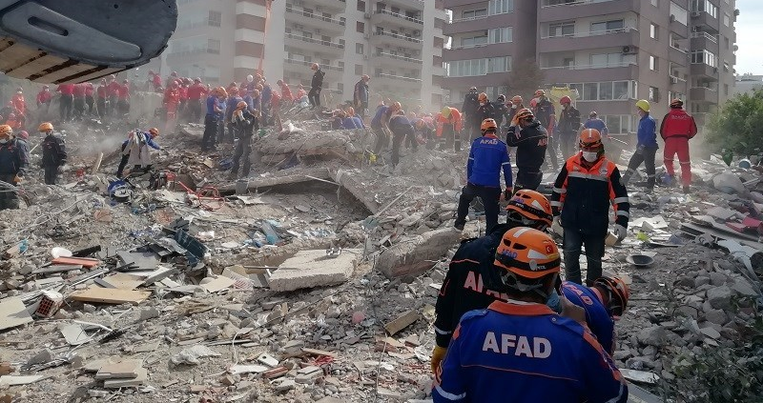
Earthquakes
Turkey: Building AFAD National System
From Fragmented Response to Coordinated Action
Turkey transformed its disaster approach by creating AFAD, a unified national agency coordinating all aspects of disaster management - from prevention and preparedness to response and recovery.
The Challenge
Before AFAD, Turkey disaster response involved multiple agencies with unclear roles, leading to coordination problems during crises. The 1999 Marmara earthquake revealed these gaps dramatically. Different ministries and organizations worked in silos, slowing rescue efforts and aid distribution.

Slide 30
Turkey:
Building AFAD National System
Creating AFAD
In 2009, Turkey established AFAD as a single coordinating body under the Prime Minister's office. AFAD brought together expertise from civil defense, emergency management, and earthquake preparedness into one streamlined organization. They created a national emergency response plan with clear roles for every agency.
How It Works
AFAD operates at three levels: national headquarters in Ankara provides strategic coordination, 81 provincial directorates manage local response, and a network of trained volunteers supports operations. They maintain emergency stockpiles of tents, blankets, and supplies across the country. When disaster strikes, AFAD activates a 24/7 coordination center, deploying resources and managing response from rescue to recovery.
Volunteer Power
AFAD built a citizen volunteer system, training tens of thousands in search and rescue, first aid, and emergency response. These volunteers become first responders in their own communities, providing crucial help in the critical first hours after disaster.
Key Lesson.
Effective disaster response requires clear coordination, prepared resources, and empowered communities. By unifying command and training citizens, nations can respond faster and more effectively when crisis strikes.

Slide 31
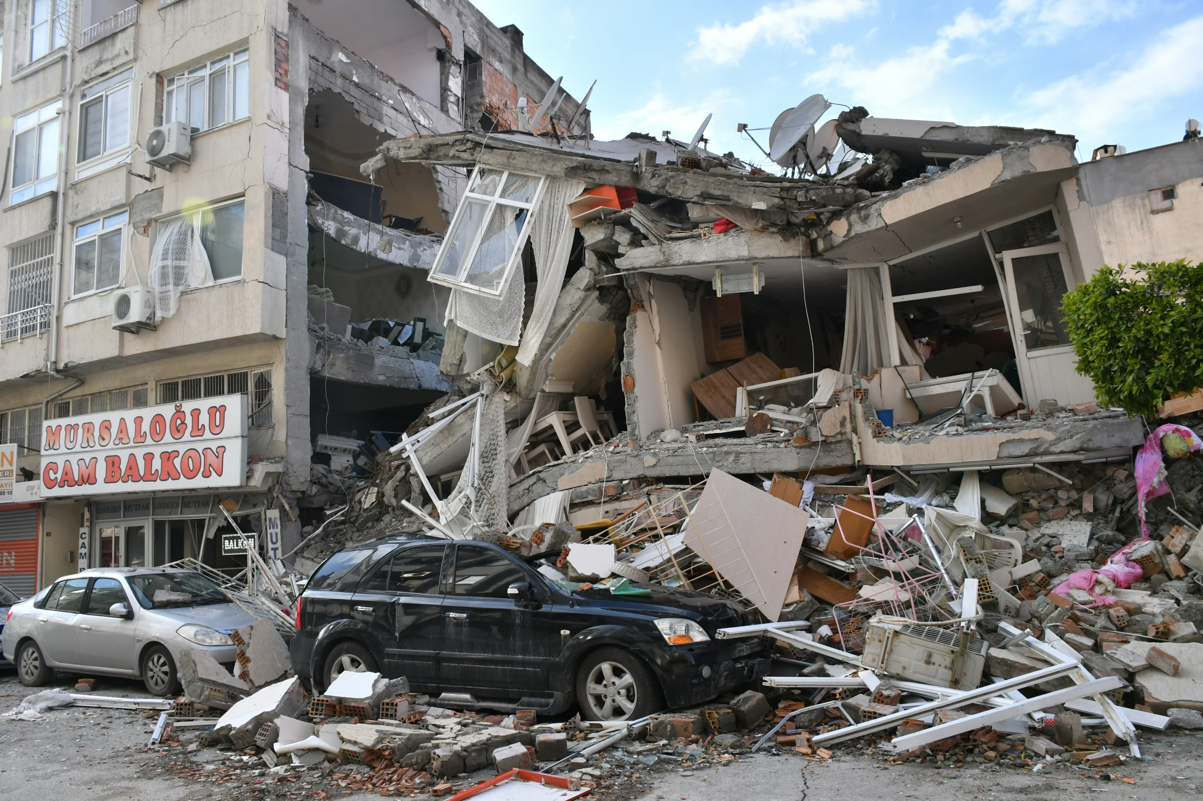
Earthquakes
Turkey: 2023 Kahramanmara Earthquakes
Community Resilience in the Face of Catastrophe
On February 6, 2023, two massive earthquakes struck southeastern Turkey within hours, creating one of the deadliest natural disasters in the country's modern history. The response demonstrated both the strength of Turkey disaster systems and the power of community solidarity.
The Catastrophe
At 4:17 AM, a magnitude 7.7 earthquake struck near Kahramanmara, followed nine hours later by magnitude 7.6. The timing-in the middle of a cold winter night-maximized the tragedy. Entire apartment buildings pancaked, trapping thousands. Eleven provinces were severely affected, with over 50,000 deaths and millions displaced.

Slide 32
Turkey: 2023
Kahramanmara Earthquakes
Immediate Response
Within hours, Turkey mobilized its largest emergency response in history. AFAD deployed search and rescue teams from across the country. Thousands of volunteers rushed to help, digging through rubble with bare hands. International rescue teams from over 80 countries joined the effort. Despite freezing temperatures and damaged roads, rescuers worked around the clock, pulling survivors from collapsed buildings days after the quake.
Shelter and Recovery
With hundreds of thousands of homes destroyed and winter temperatures below freezing, providing shelter became critical. Container cities-temporary housing made of insulated shipping containers-were rapidly constructed. Community kitchens served hot meals. Mobile health clinics provided medical care. Psychosocial support teams helped people process trauma. The government launched a massive reconstruction program to build earthquake-resistant housing.
Community Solidarity
The response showcased extraordinary solidarity. Neighbors helped neighbors. Businesses donated supplies. Medical professionals volunteered in affected areas. The Turkish diaspora raised funds globally. This collective effort helped communities begin healing and rebuilding.
Key Lesson.
Even with strong systems in place, major disasters test every capacity. Community solidarity, combined with organized response systems and modern building standards, makes the difference between catastrophe and recovery.

Slide 33
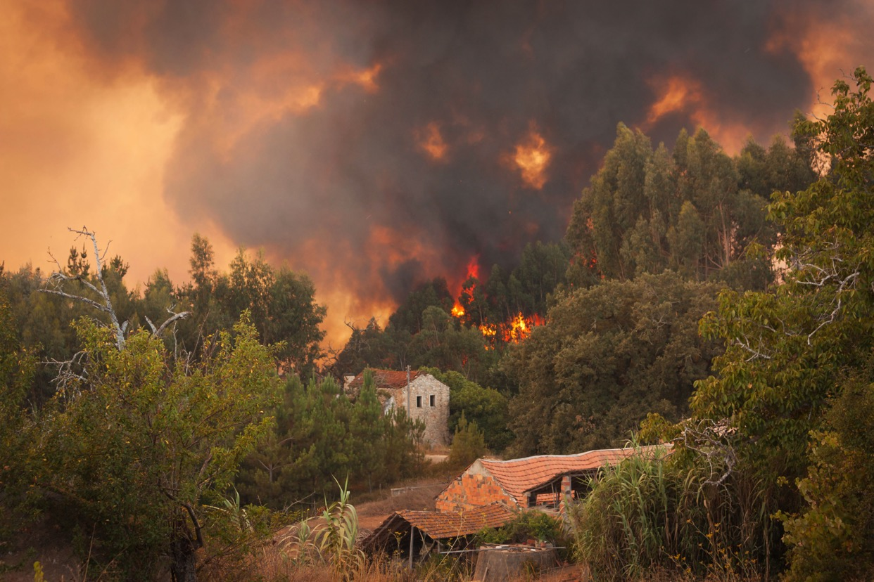
04
Wildfires
Climate change is making wildfires more frequent and intense across Europe. Spain 2025 fire season demonstrated both the challenge of extreme fire weather and the importance of coordinated emergency response, prevention strategies, and community evacuation planning.
Click to type…

Slide 34
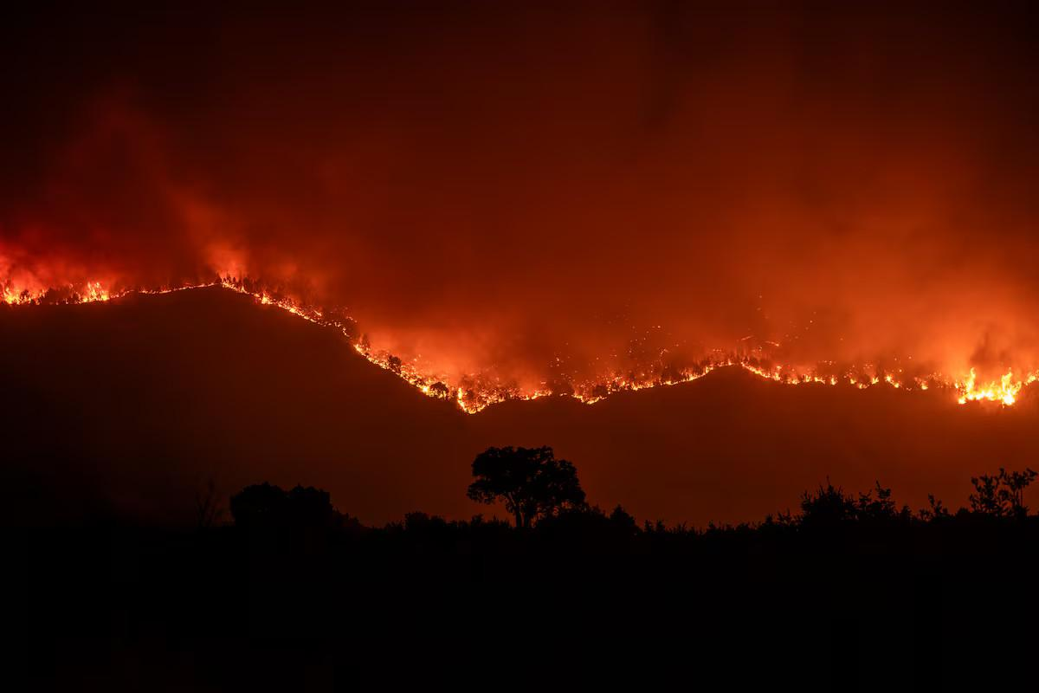
Wildfires
Spain: 2025 Wildfire Season
Fighting Fires in a Changing Climate
The summer of 2025 brought an exceptionally severe wildfire season to Spain, with multiple large fires burning simultaneously across the country. The response required massive coordination of firefighting resources and demonstrated the growing challenge
of wildfire management in a warming climate.
The Challenge
Summer 2025 brought extreme heat and drought to Spain, creating perfect wildfire conditions. Multiple
fires ignited across the country, stretching firefighting resources to their limits. Some fires burned for
weeks, consuming thousands of hectares of forest and threatening communities.

Slide 35
Spain: 2025
Wildfire Season
Coordinated Response
Spain mobilized its national firefighting resources, including ground crews, water-bombing aircraft, and military support. Regional fire services coordinated operations across jurisdictional boundaries. Meteorological services provided fire weather forecasts. Early warning systems alerted communities to evacuation risks. International firefighting teams from European partners reinforced Spanish crews.
Community Evacuations
Multiple communities faced evacuation orders. Local authorities activated emergency plans, using multiple communication channels to reach residents. Evacuation centers provided shelter and support. Once fires passed, damage assessment teams helped residents return safely and begin recovery.
Prevention and Adaptation
The severe season reinforced the need for prevention strategies: fuel management reducing fire-prone vegetation, firebreak creation around communities, building codes requiring fire-resistant materials and defensible space, public education about fire prevention and safety, and land-use planning that considers wildfire risk.
Key Lesson.
Climate change is making wildfires more frequent and severe. Effective response requires coordinated firefighting resources, clear evacuation procedures, and community preparedness. Long-term adaptation demands prevention strategies, fire-wise building codes, and land management that reduces wildfire risk.

Slide 36
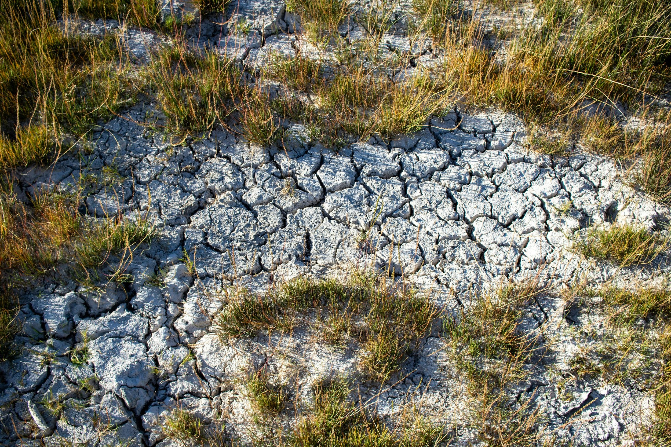
05
Environmental Disasters
The 2018 VAIA storm in Italy created not just immediate devastation but long-term environmental challenges. The recovery effort demonstrates how communities can rebuild while adapting to climate change, combining ecological restoration with sustainable development.
Click to type…

Slide 37
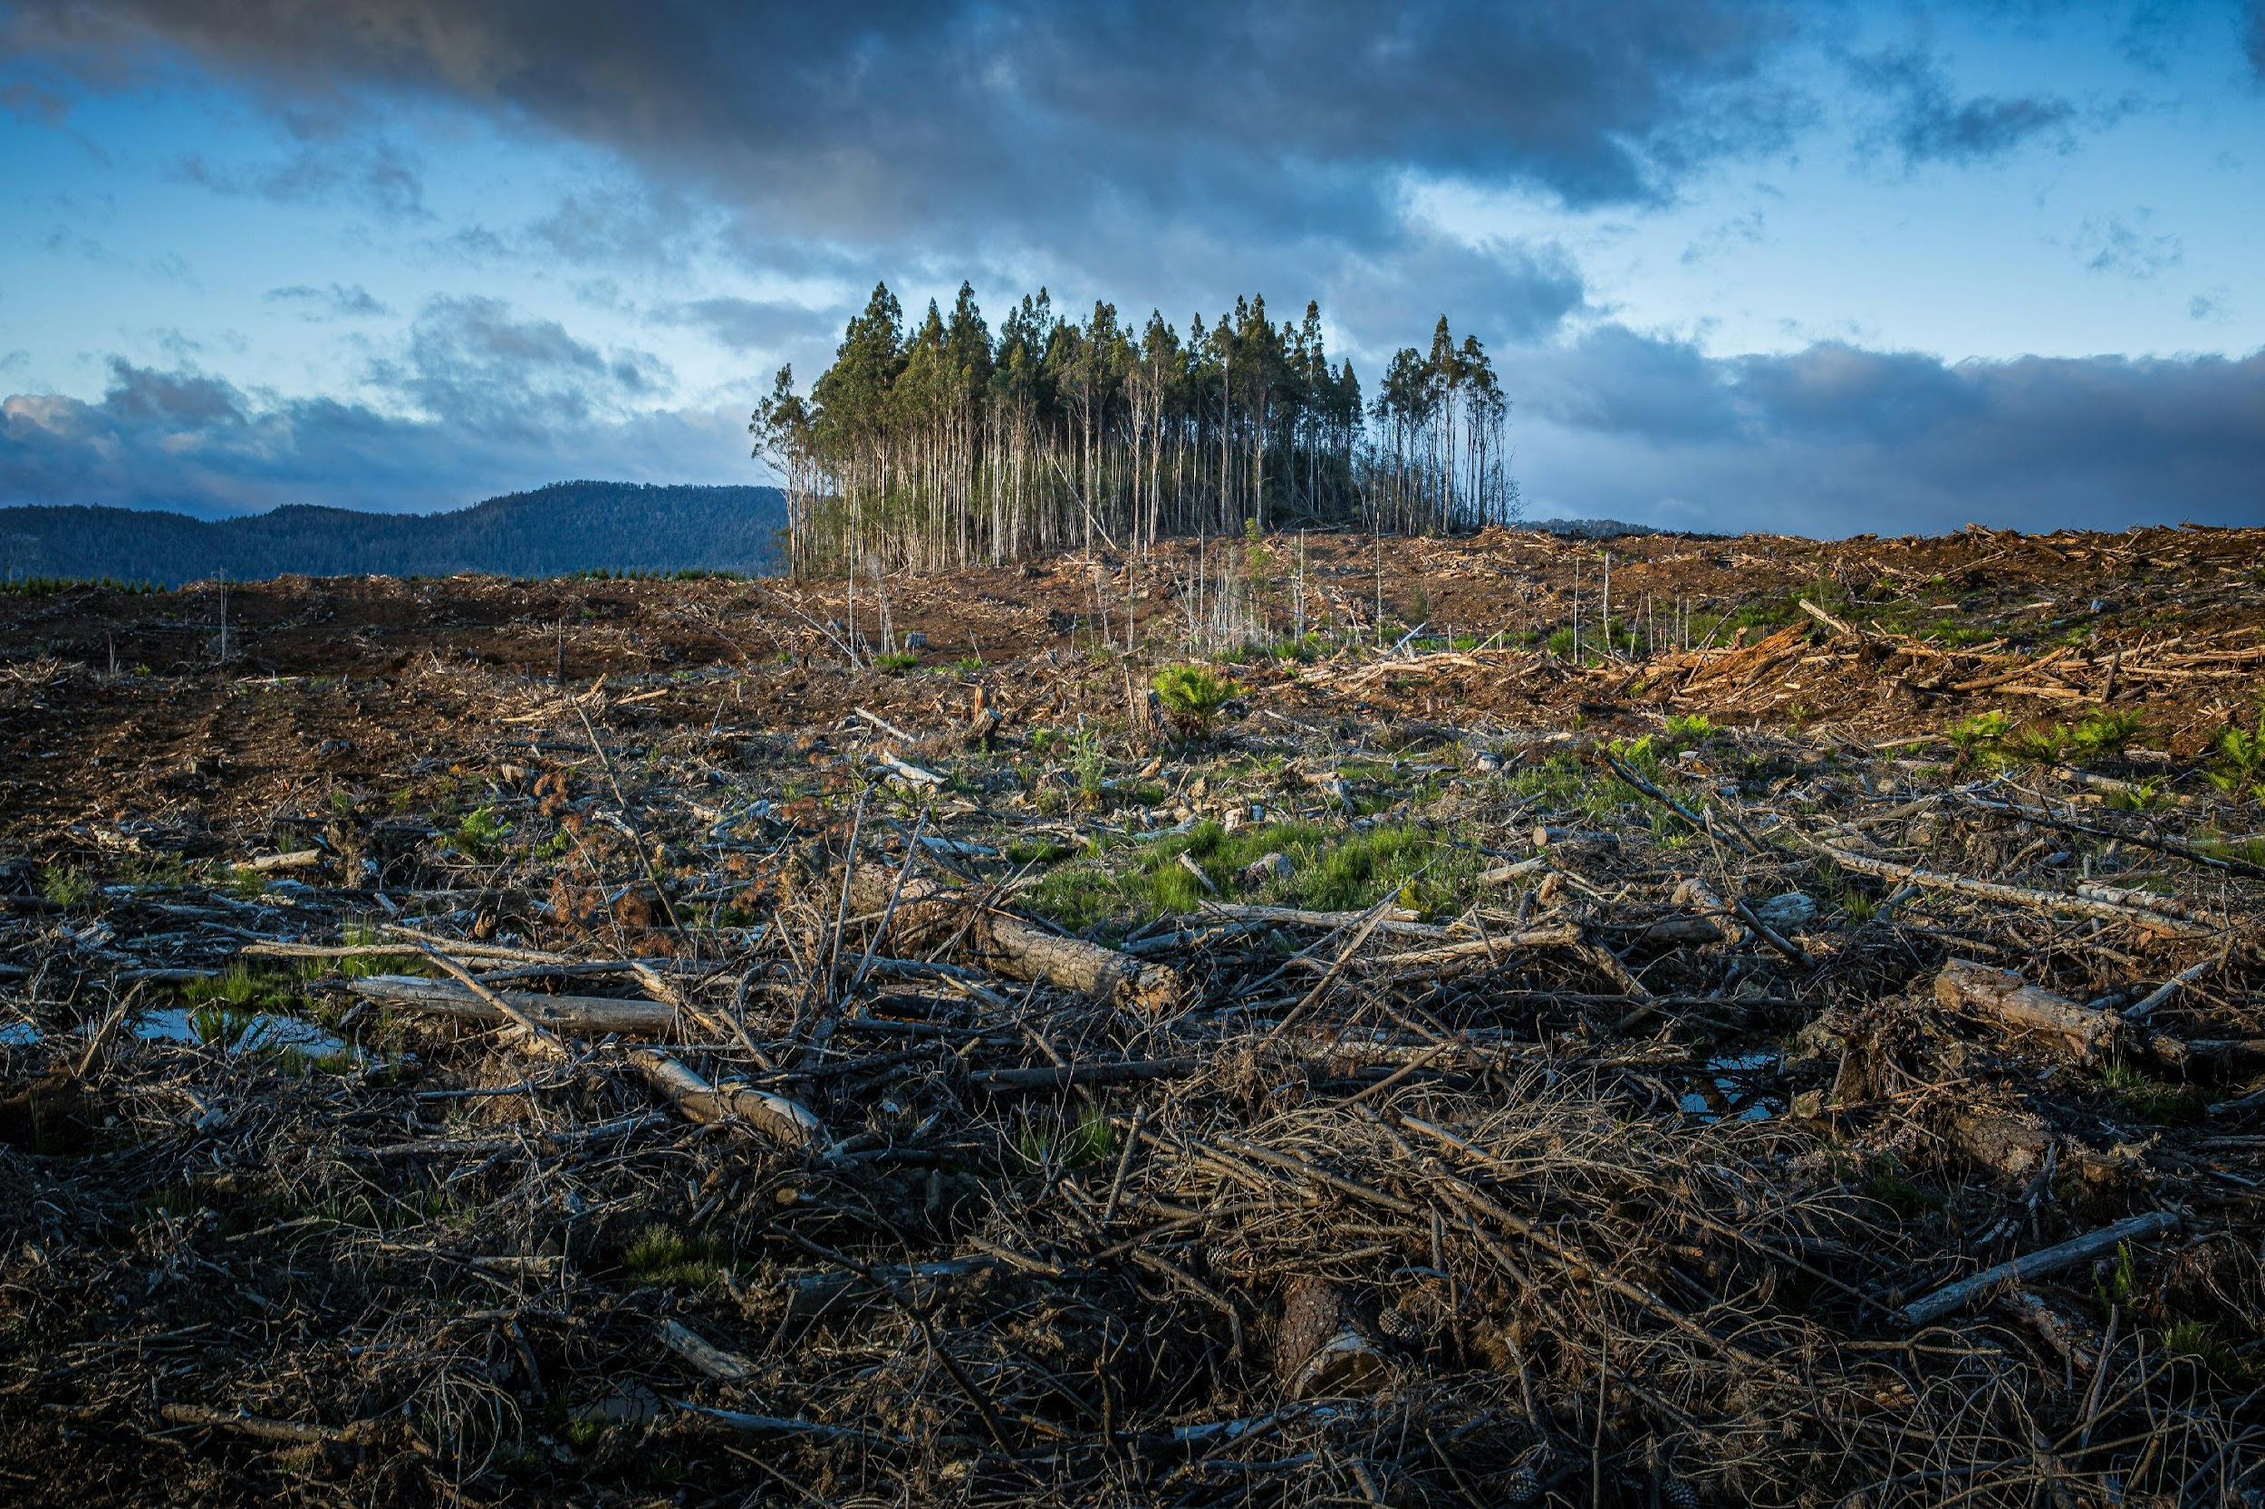
Environmental Disasters
Italy: 2018 VAIA Storm Forest Recovery
Rebuilding Forests for a Changing Climate
In October 2018, the VAIA storm devastated forests across northeastern Italy, flattening millions of trees. The recovery effort, ongoing today, combines ecological restoration with climate adaptation, demonstrating how environmental disasters require long-term, holistic responses.
The Storm
The VAIA storm brought hurricane-force winds exceeding 200 km/h to northeastern Italy. In forests across Trentino-Alto Adige, Veneto, and Friuli-Venezia Giulia, millions of trees were flattened in hours. Over 42 million cubic meters of timber - representing decades of forest growth - lay destroyed. The environmental and economic impacts were enormous.

Slide 38
Italy: 2018
VAIA Storm Forest Recovery
Immediate Response
Italian Civil Protection coordinated the immediate response with regional governments and local forestry services. Priority was removing fallen trees from roads and infrastructure, preventing landslides in deforested areas, securing dangerous situations, and salvaging usable timber before it rotted or became infested.
Long-Term Recovery: The LIFE VAIA Project
Launched in 2021, the EU-funded LIFE VAIA Project leads long-term forest recovery and climate adaptation. The project focuses on ecological restoration using diverse, climate-resilient tree species rather than monoculture replanting, creating forests that can better withstand future storms and climate change. It includes research on forest adaptation strategies, community engagement in restoration, and sustainable forestry practices.
Lessons for Forest Management
VAIA highlighted vulnerabilities in forest management. Monoculture forests proved more susceptible to storm damage than diverse forests. Climate change is bringing more extreme weather events. Future forest management must prioritize diversity, resilience, and adaptation to changing conditions.
Key Lesson.
Environmental disasters require long-term, holistic recovery approaches. Rebuilding ecosystems provides opportunity to build climate resilience through diversity, adaptation, and sustainable management. Investing in ecological restoration
protects communities while preserving natural heritage.

Slide 39
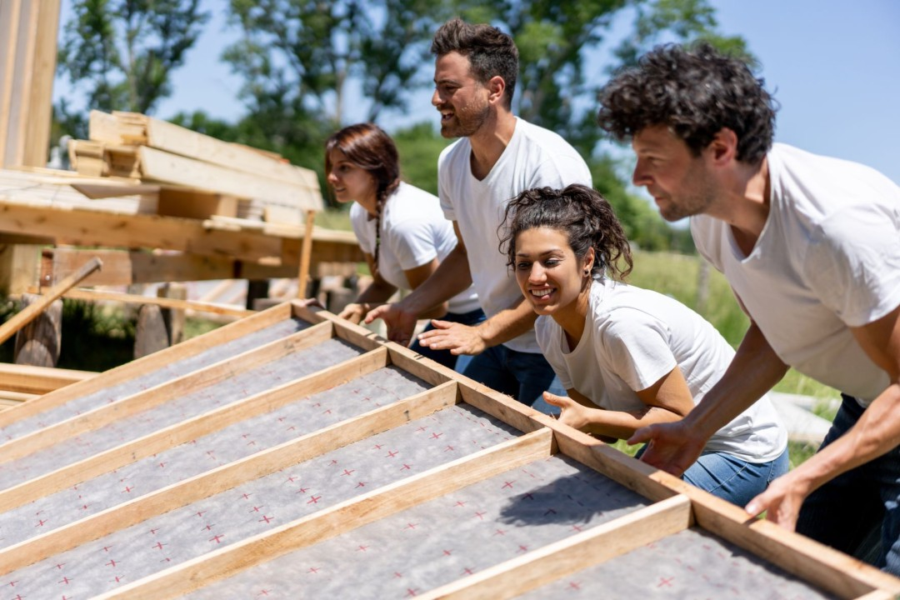
Conclusions: Building Resilient Futures
Several critical lessons emerge from this collection that transcend individual disasters and geographic boundaries:
These 14 case studies from across Europe paint a powerful picture of community resilience in action. From the rubble of earthquakes to the floodwaters of storms, from the devastation of wildfires to theongoing trauma of war, we see communities not just surviving but adapting, innovating, and emerging stronger.
Community Power
is Irreplaceable
No external agency, however well-resourced, can match the speed, local knowledge, and sustained commitment of community-led response. Whether it is 15,000 volunteers mobilizing within hours in Valencia, community resilience hubs keeping Ukrainians warm through winter, or Irish community centers serving as storm shelters, grassroots action consistently proves essential. Building community capacity - training volunteers, strengthening local organizations, fostering social networks - is not supplementary to disaster preparedness. It is foundational.
Preparation Before Crisis is Worth Ten Times Response During
Communities that invested in preparedness - whether Ireland's pre-positioned supplies and trained volunteers, Turkey's AFAD system, or Leitrim's community coordination networks - responded far more effectively when disaster struck. The time to prepare is not after crisis hits, but during the calm periods when systems can be built, relationships established, and capacities developed.
Innovation Flourishes Under Constraint
Limited resources do not prevent effective response -they inspire it. From car battery charging stations in Ukraine to social media volunteer coordination in Spain, from community kitchens with portable generators to resilience booklets distributed door-to-door, these case studies showcase remarkable frugal innovation. Communities do not need perfect solutions; they need creative, adaptable approaches that work with available resources.

Slide 40
Climate Change Demands Adaptation Now
The increasing frequency and intensity of floods, storms, and wildfires across these case studies is not
Coincidental -it reflects our changing climate. Adaptation is no longer optional. Communities must invest in climate-resilient infrastructure, early warning systems, nature-based solutions, and preparedness
programs. The cost of inaction far exceeds the investment in adaptation.
Recovery is a Marathon, Not a Sprint
Media attention fades after the immediate crisis, but communities face years of recovery. Sustainable resilience requires long-term commitment: trauma support, economic recovery assistance, infrastructure
reconstruction, and implementation of lessons learned. Short-term emergency aid must be complemented by sustained recovery support that helps communities rebuild stronger.
Moving Forward: From Knowledge to Action
01. For communities:
Begin preparing now. Build local networks. Train volunteers. Establish coordination systems. Pre-position supplies. Conduct drills. Foster the social connections that become lifelines during crisis.
02. For educators:
Integrate these case studies into adult education programs. Use real examples to teach disaster preparedness. Help learners understand both the challenges and the possibilities of community resilience.
03. For policymakers:
Support community-led preparedness initiatives. Invest in coordination systems that empower local action. Create policies that enable rapid response while building long-term resilience. Fund adaptation measures before disasters strike.
04. For all of us:
Recognize that disaster resilience is not someone else's responsibility - it is a collective endeavor requiring participation from everyone. The volunteers who rushed to Valencia, the community leaders who opened storm shelters in Ireland, the grassroots organizers who created resilience hubs in Ukraine - they are ordinary people who chose to act. We can all be part of building more resilient communities.
This collection documents what works. The question now is: how do we translate these lessons into
action?

Slide 41
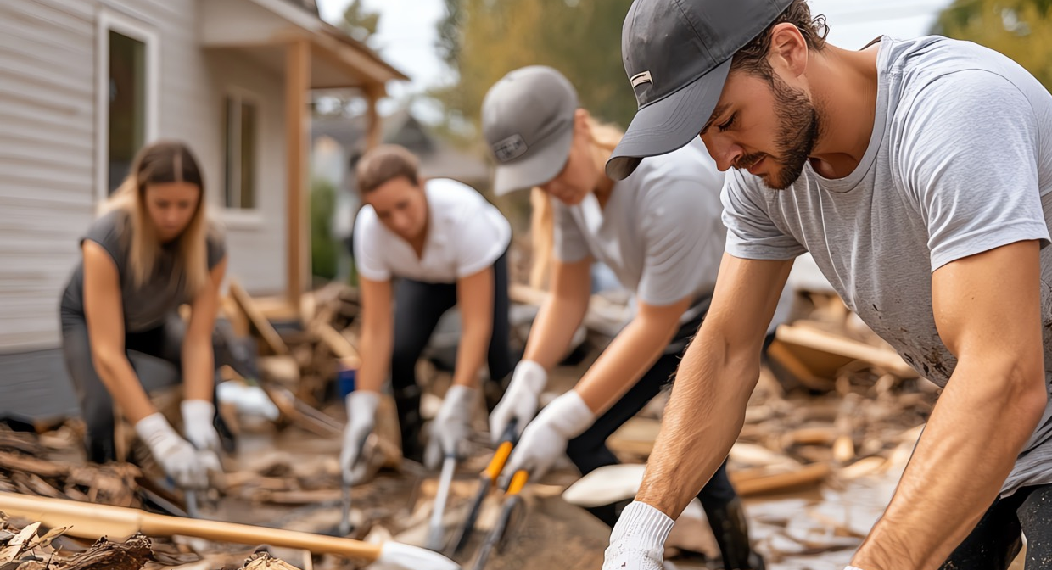
The RISE Legacy
The RISE Resilient Communities project aims to ensure these lessons reach those who need them. Through adult education programs, digital learning platforms, and innovation labs, we are working to build capacity for disaster resilience across Europe. This case study collection is one step in that journey - documenting what works, sharing knowledge, and inspiring action.
But the real work happens in communities like yours. These case studies show what is possible when communities prepare, respond effectively, and learn from experience. They demonstrate that resilience is
not about preventing all disasters - that is impossible - but about building the capacity to withstand shocks, adapt to challenges, and emerge stronger.
The future will bring more disasters. Climate change, geopolitical instability, and other challenges guarantee that. But it will also bring more communities prepared to face these challenges, more volunteers ready to help, more innovative solutions, and more resilient futures. This collection is part of making that future possible.
From the ruins of the 1999 Marmara earthquake to the floods of 2024 Valencia, from
war-torn Ukraine to storm-battered Ireland, communities have shown us what resilience
looks like. Now it is our turn to learn, prepare, and build the resilient communities that
tomorrow demands.

Slide 42

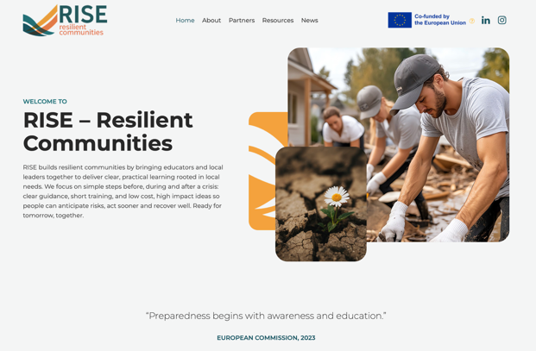
Click to Visit
Follow Our Journey
li
in
www.resilientcommunitiesrise.eu

